Slide 1
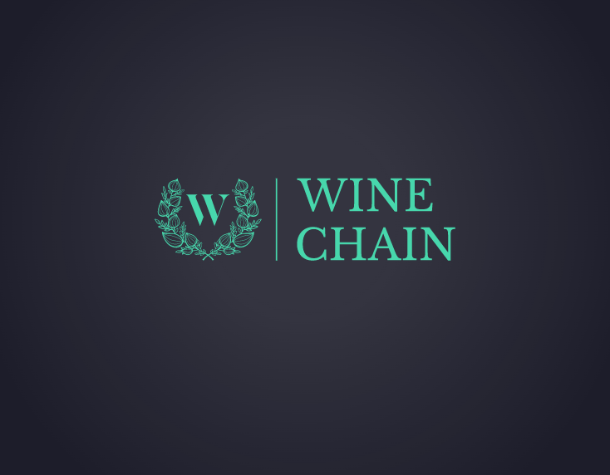
FIN-TECH PROJECT 3 Wine-chain
Bill Tang
Eric mcglade
Blandine ishimwe
Domenic chiaromonte

Slide 2
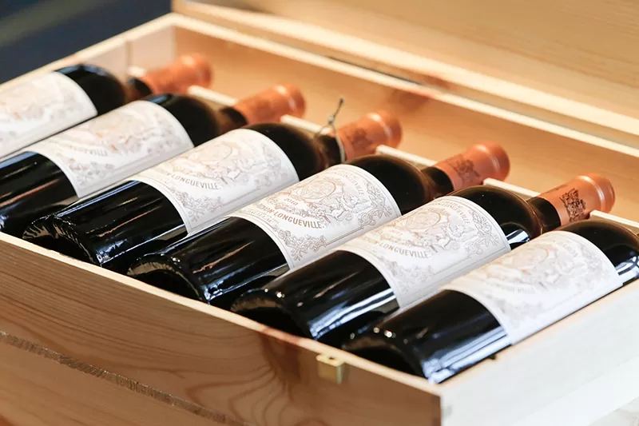
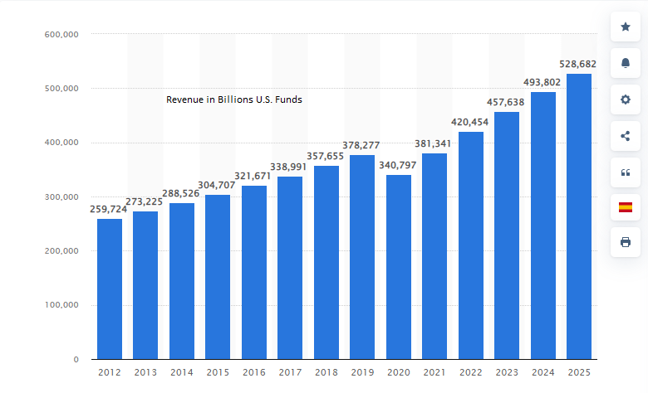
GLOBAL WINE SALES
In 2021 Global wine sales hit $381,000,000,000.00
There is a projected growth of 72% by 2025

Slide 3
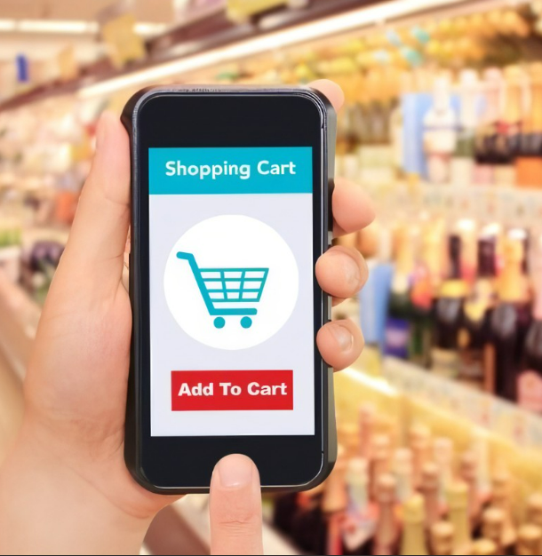
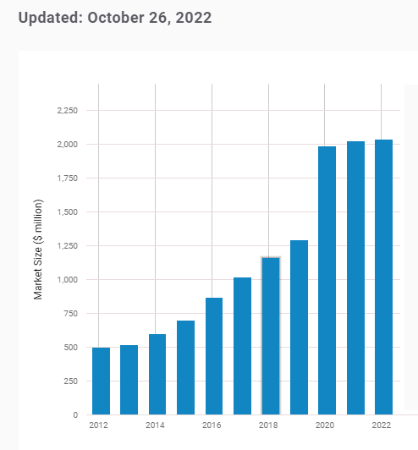
Wine accounts for 65% of all online alcohol sales
Online wine sales account for about 1% of total wine sales globally
By 2025 that number is projected to reach 5% globally
Online Wine Sales
Market Size Billions (U.S.dollars)

Slide 4

GLOBAL WINE SALES COMPARISON
“E-commerce will be the No. 1 driver of beverage alcohol industry growth over the next decade”, according to Bourcard Nesin, a RaboResearch Food & AgriBusiness beverages analyst and author
.
2022 Global Wine Sales
2022 Global OnLine Wine Sales
$2.27B
$????
$381 B
Crypto based Wine sales
"Companies that fail to proactively invest in their e-commerce teams will struggle to remain relevant and retain market share,"

Slide 5






OUR GOAL
Take advantage of the growing online wine sales market
The wine industry, has notoriously been resistant to technology, but our target market is Millennials and even Gen Z who are very into wine and updated technology turning a dated hobby and dining experience for older generations into something far more accessible for newer generations.
Trust
Create a trusted blockchain secured payment
option
Cost
INCREASING ON-LINE WINE SALES
INCREASED DISPOSABLE INCOME
Margins
Controlled cost
Limited labor
Lower overhead costs
Focus on Gen Z
And Millennials

Slide 6



Solution
Create a web3 decentralized Blockchain
Crypto currency wine store.
Frictionless online buying
Transparency
Secure

Slide 7





Our Product
Unique
One of first to Market
Tested
Authenticate

Slide 8
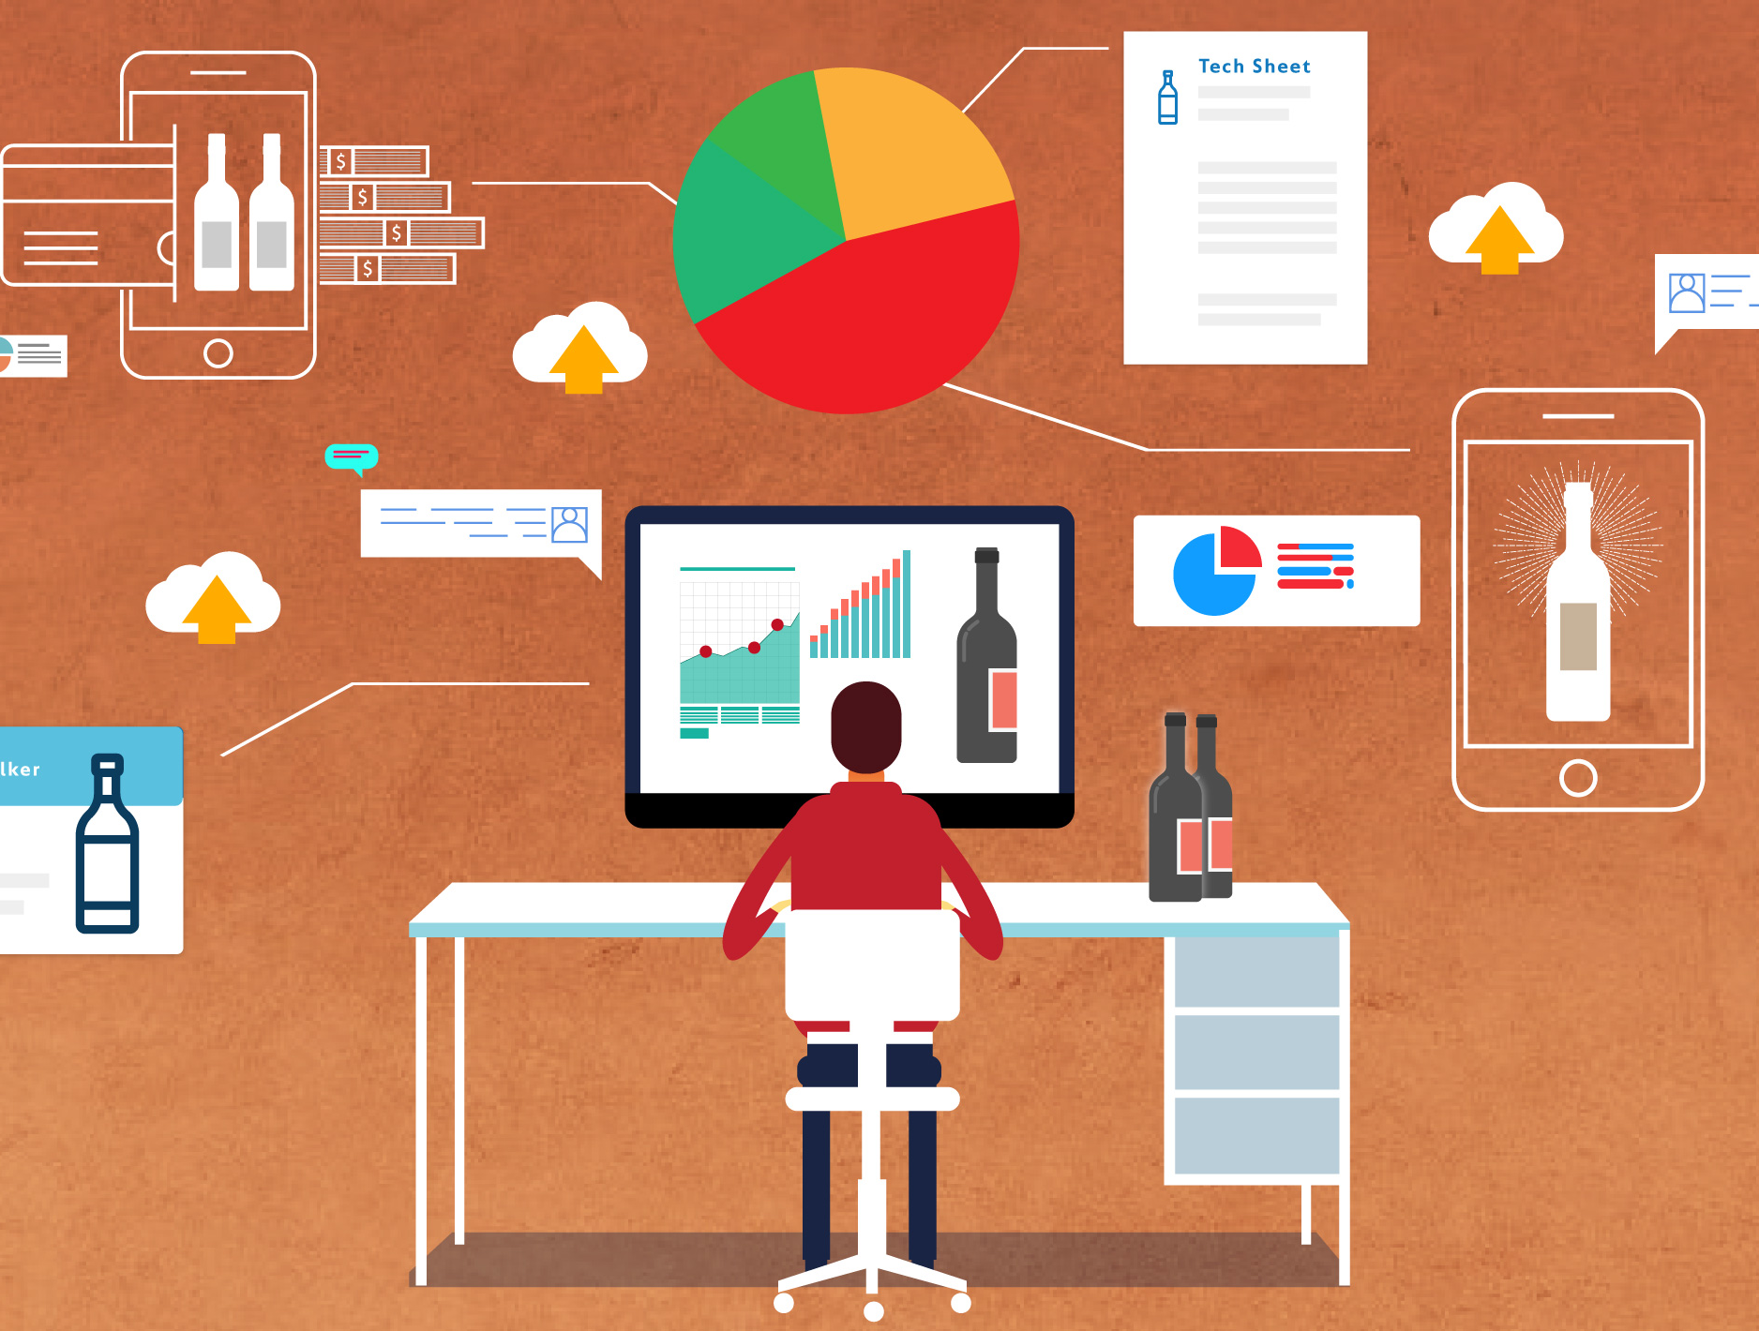
Under the Grape leaves
Technologies Used:
Python - Programming language
Solidity - Programming language
Jupyterlab - notebook to code the store front and data analytics/visualizations for wine sales
Ganache - build a test network
Remix.Ethereum - create and deploy a contract and test transactions
GitHub - store and transfer project files
Metamask - connect ganache to remix and facilitate the test transactions
Libraries:
Wallet_connect - To connect our store to a verified crypto wallet
Flask - Build and share store front web application
Languages:
Javascript
Html

Slide 9

Summary
Our Goal was to create web3 based wine store that ran on the Ethereum network that accepted Ethereum Coins as payment
By utilizing:
Python
Solidity
Jupyterlab
Ganache -
Remix.Ethereum
GitHub
Along with
Libraries:
Wallet_connect
Flask
Languages:
Javascript
Html
We were able to create:
1) A Streamlit landing page to purchase wines in Eth
2) A basket purchasing Landing Page using Flask with a Connect-Wallet feature

Slide 10



Thank You
WINE-CHAIN
Blandine91/Wine-Chain: Wine-Chain (github.com)

